Slide 1
Floor Cleaning Robot
By Vinayak Renukdas
Aditya Bodhi
Ghananshu Desale

Slide 2
Content
Introduction
Inspiration
Block Diagram
Components used
Circuit Diagram

Slide 3
Introduction
In today’s world automation is on the rise and now it has entered out homes as well. One thing that has become automated is cleaning, particularly floor cleaning.
This project will help us create a smart and compact floor cleaning robot that is budget friendly as well as beginner friendly for someone who is interested in Robotics and DIY.

Slide 4
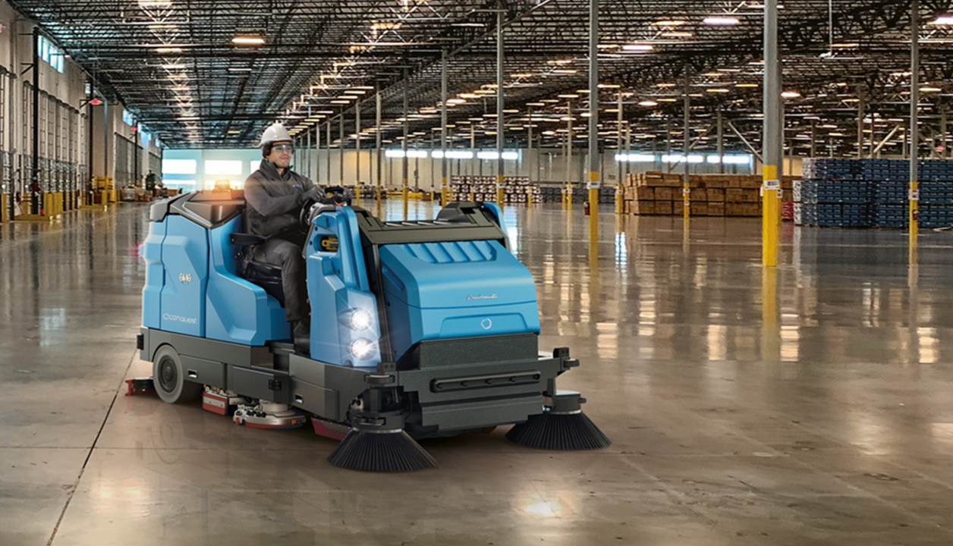
Inspiration
The idea to build this inspired from industrial sweepers.
We decided to build a compact and remote-controlled/autonomous version of it.

Slide 5
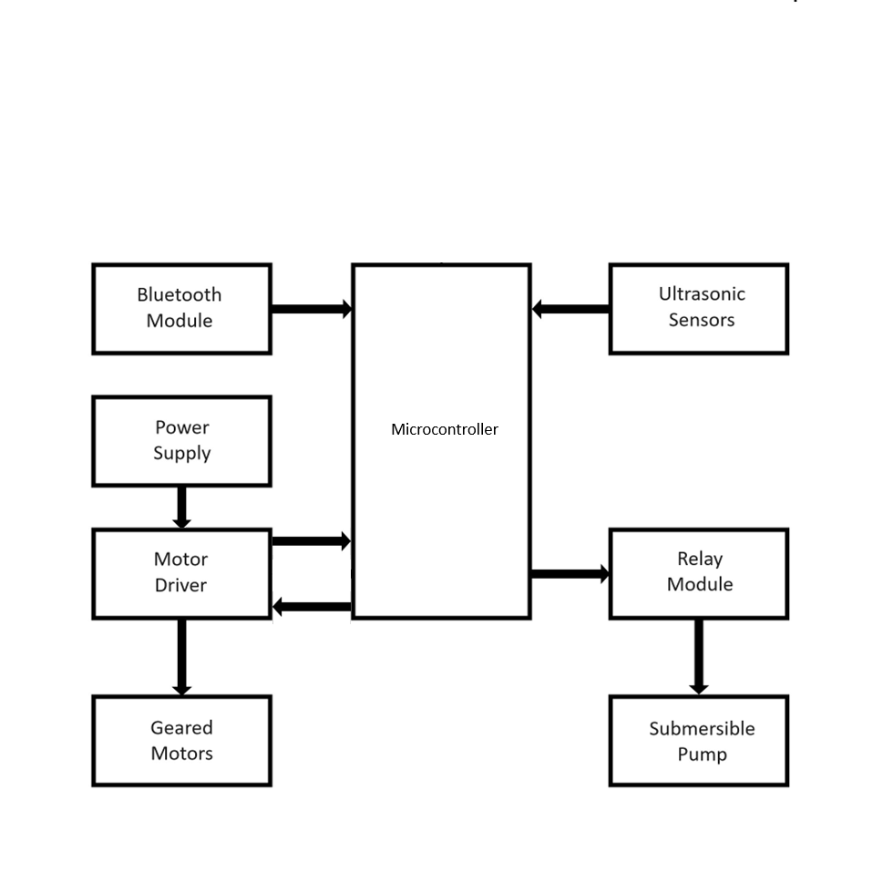
Block Diagram

Slide 6
Components used
We used the following components to build this project
Arduino Nano – It serves as the brain of the system
L298N Motor Driver– It will manage the operation of all four motors
HC-05 Bluetooth Module – It connects the robot to the smartphone, allowing remote control.
HCSR-04 Ultrasonic Sensor – It helps in detecting the detect obstacle in the front of the robot to avoid collisions.
Relay Module: It turns the submersible pump on and off
Wheeled Motors: It helps the robot to move on the floor
Disk motors: It has sponge attached to it which will help in wiping the floor
Submersible pump: It dispenses cleaning liquid onto the floor

Slide 7
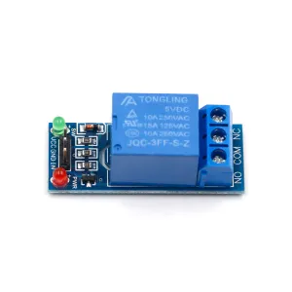
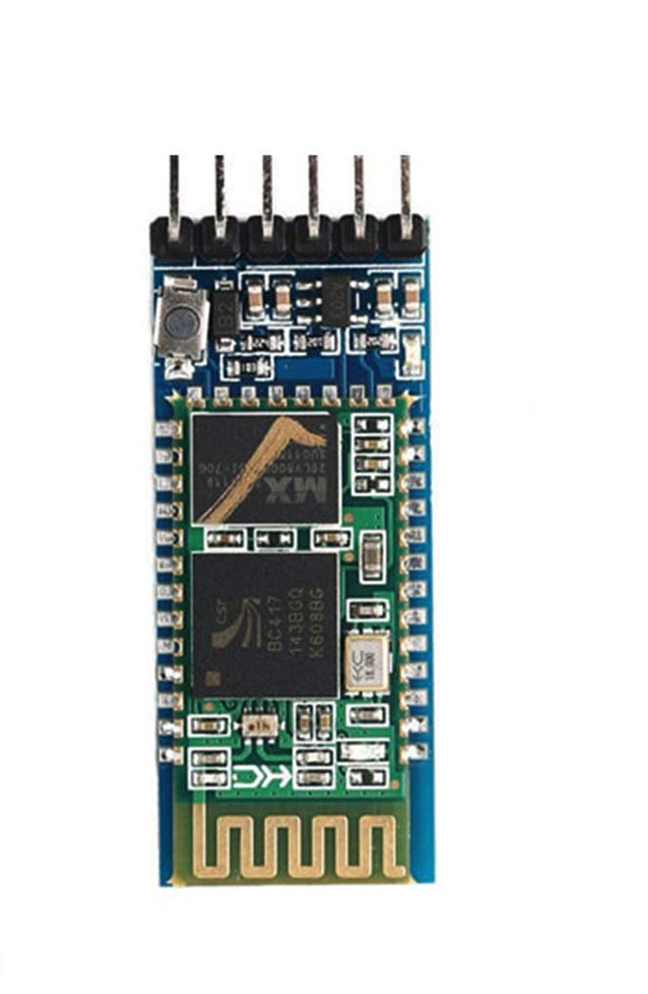
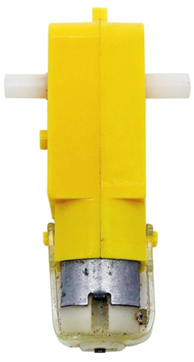
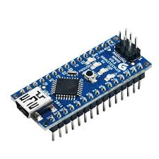
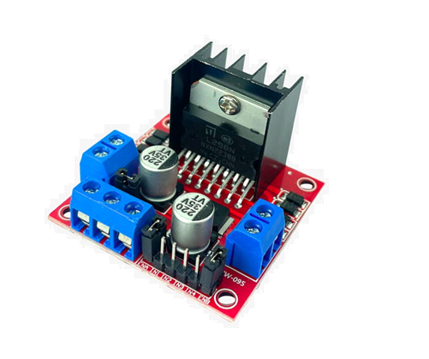
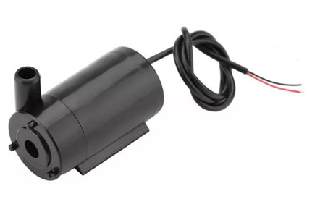
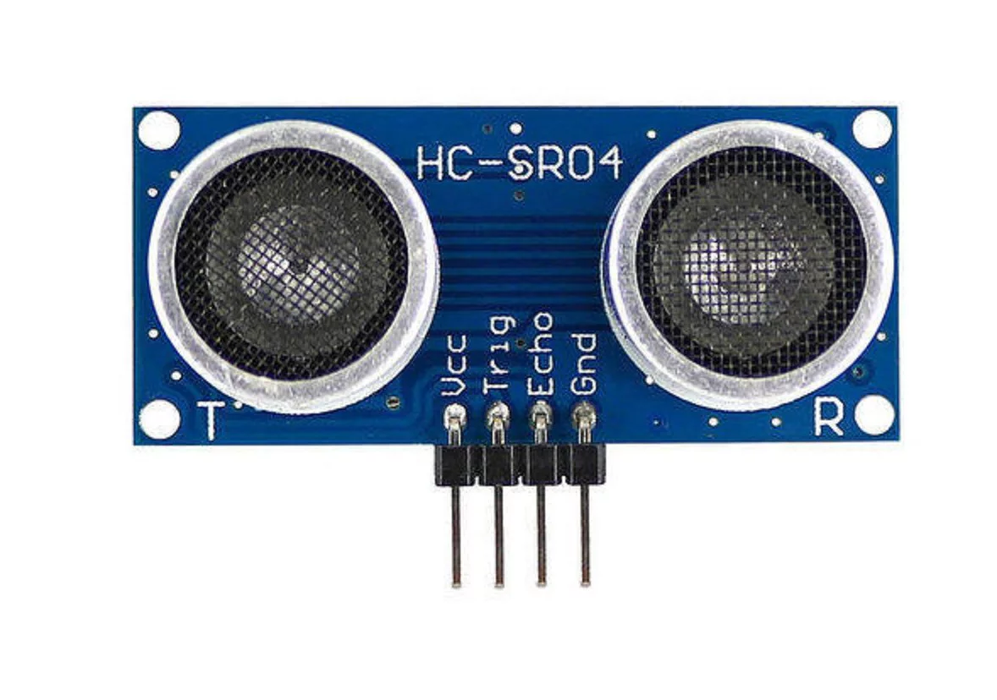
Components used

Slide 8
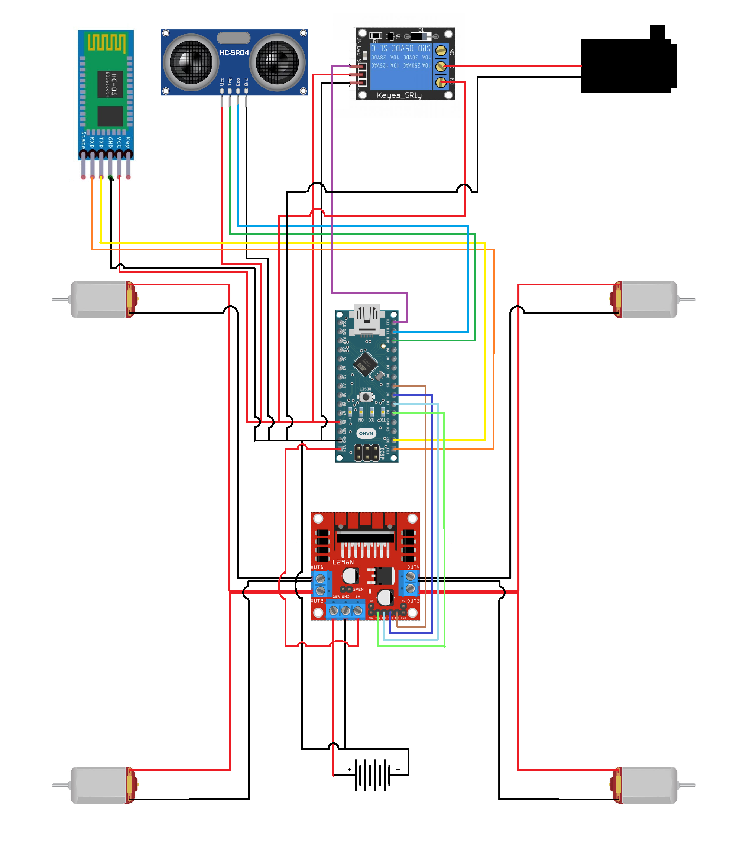
Wiring Plan

Slide 9
Working
When you switch on the robot, it initiates in the Bluetooth control mode.
After turning it on connect your smartphone to Bluetooth module using the Arduino Blueooth Control mobile app.

